Slide 1
Systemizing Prototypes
Photo by keepingtime_ca from https://www.flickr.com/photos/keepingtime_ca/3646050634 (CC-BY-SA 2.0)

Slide 2
Learning Goals
Understand why prototypes are useful
Know different ways to systemize prototypes
Systemizing Prototypes

Slide 3
ISO 9241-210 Human-Centered Design Process
Plan the human-centered design process
Design solution meets the user requirements
Understand and specify the context of use
Evaluate designs against requirements
Specify the user and organizational requirements
Product design solutions to meet the user requirements
ISO 9241-210:2019 (en) Human-centered design for interactive systems
Systemizing Prototypes

Slide 4
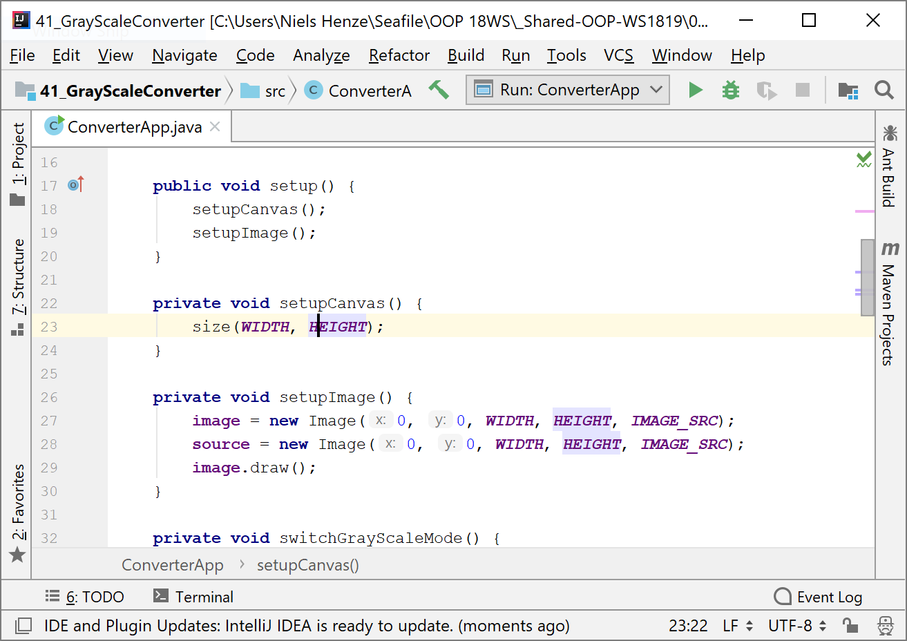
ISO 9241-210 Human-Centered Design Process
the whole process
becomes very slow
Plan the human-centered design process
Design solution meets the user requirements
Understand and specify the context of use
Evaluate designs against requirements
Specify the user and organizational requirements
very slow
Product design solutions to meet the user requirements
ISO 9241-210:2019 (en) Human-centered design for interactive systems
Systemizing Prototypes

Slide 5
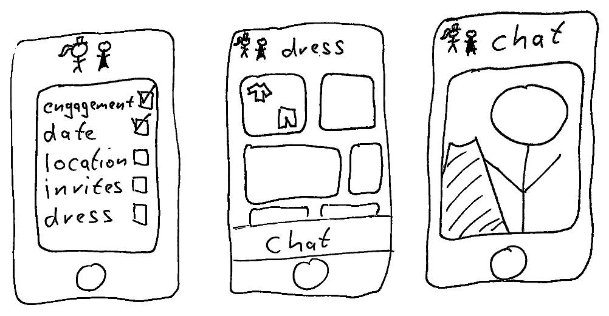
ISO 9241-210 Human-Centered Design Process
the whole process
becomes very fast
Plan the human-centered design process
Design solution meets the user requirements
Understand and specify the context of use
Evaluate designs against requirements
Specify the user and organizational requirements
very
fast
ISO 9241-210:2019 (en) Human-centered design for interactive systems
Systemizing Prototypes

Slide 6
Minimize the time for early design Iterations
Make errors quickly!
Enables to explore more design options
Systemizing Prototypes

Slide 7
Definitions for Prototyping
“A concrete representation of part or all of an interactive system”
Beaudouin-Lafon, M., & Mackay, W. E. (2009). Prototyping tools and techniques. In Human-Computer Interaction (pp. 137-160). CRC Press.
“Prototyping models your final product and allows you to test attributes of the final product even if it's not ready yet.”
Horn, J. (1998). The usability methods toolbox handbook. San Jose State University: Industrial and Systems Engineering Department, San Jose, CA.
Dynamic visual model providing a communication tool for customer and developer that is far more effective than narrative prose or static visual models for portraying functionality. It has been described as:
functional after a minimal amount of effort
a means for providing users of a proposed application with a physical representation of key parts of the system before system implementation
flexible, modifications require minimal effort
not necessarily representative of a complete system.
Connell, J. L., & Shafer, L. (1989). Structured rapid prototyping: an evolutionary approach to software development. Yourdon Press.
Systemizing Prototypes

Slide 8
What to Prototype?
Work flow, task design
Screen layouts and information displays
Difficult, controversial, critical areas
Everything else considered important...
Systemizing Prototypes

Slide 9
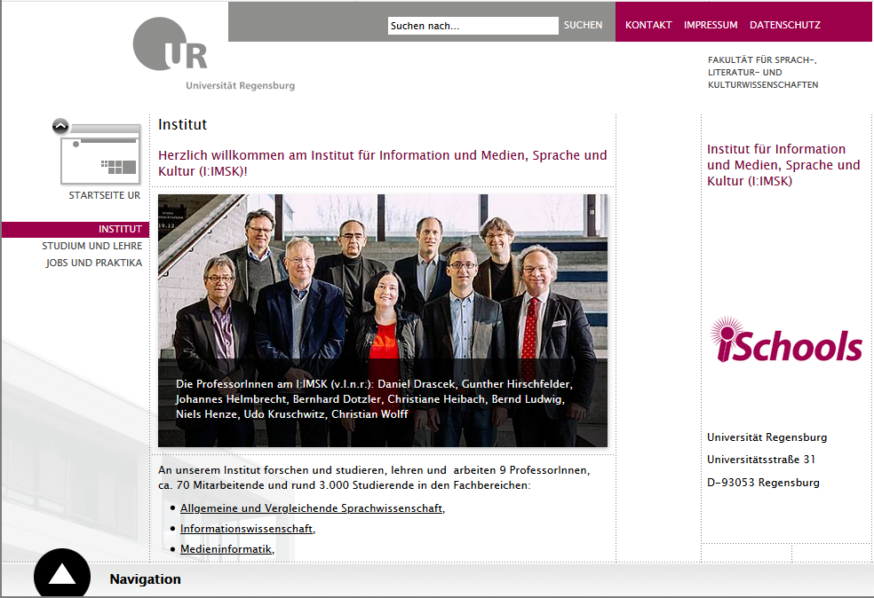
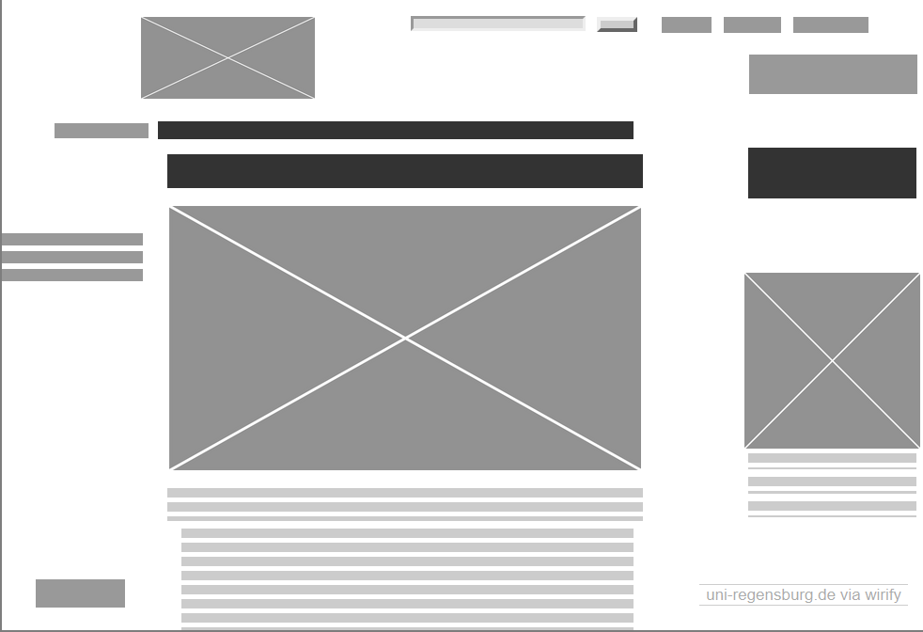
Prototypes for GUIs
Systemizing Prototypes

Slide 10
Taxonomy of Prototypes
Horizontal vs. Vertical Prototypes
Low-Fidelity vs. High-Fidelity Prototypes
Non-Functional vs. Functional Prototypes
Evolutionary prototypes vs. throw away prototypes
Systemizing Prototypes

Slide 11
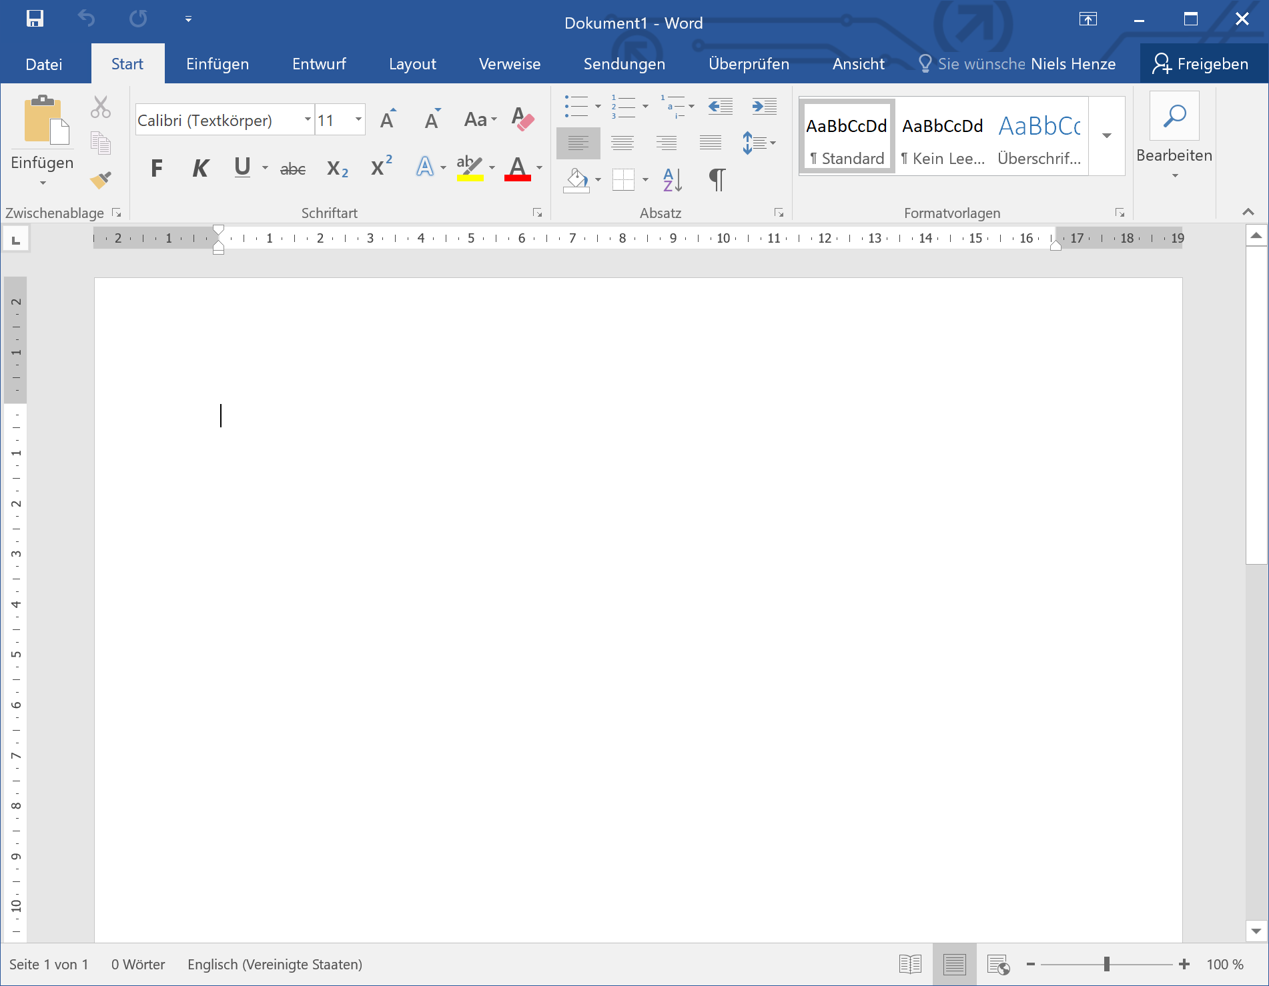
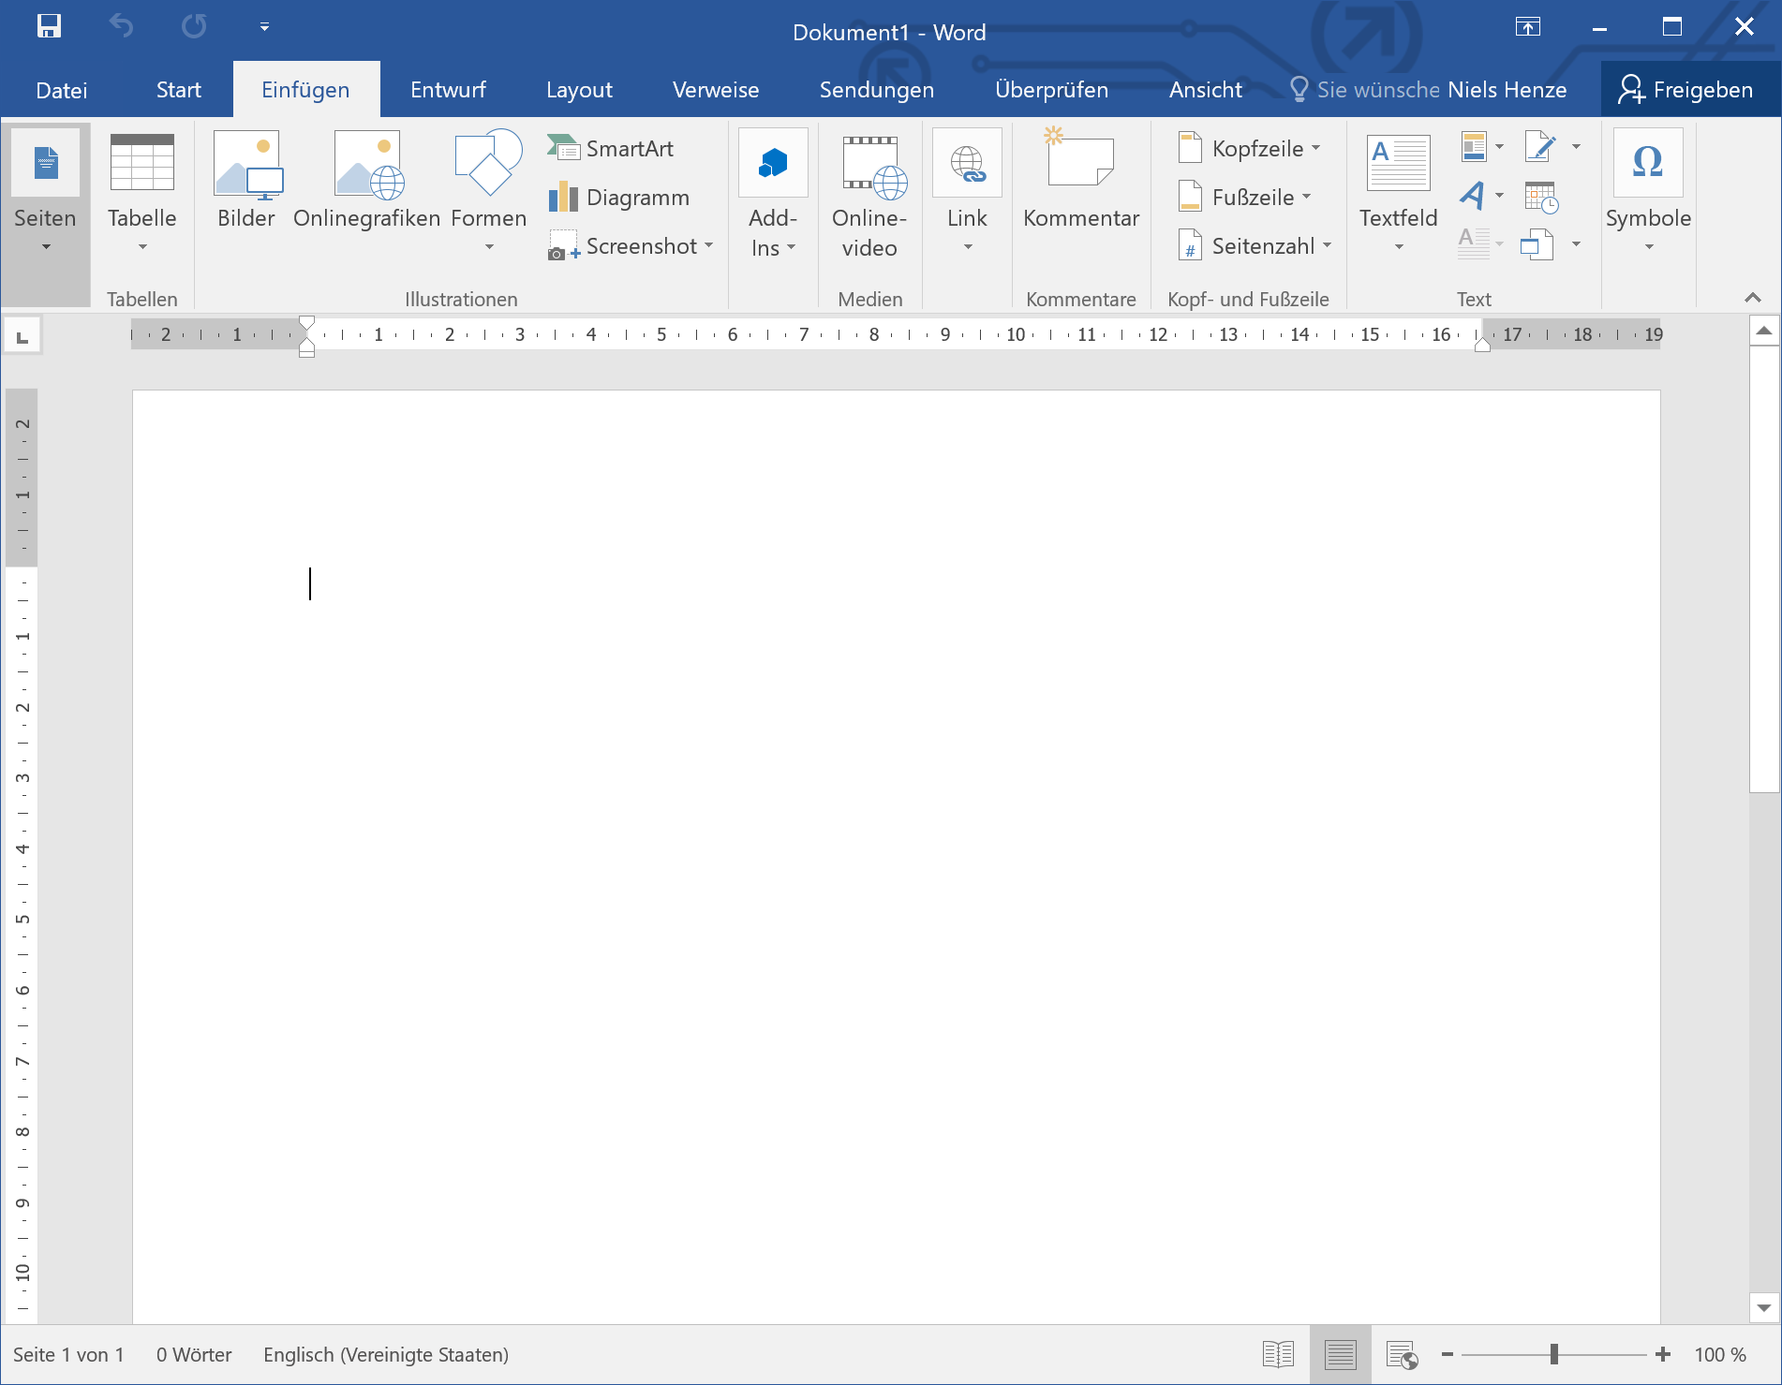
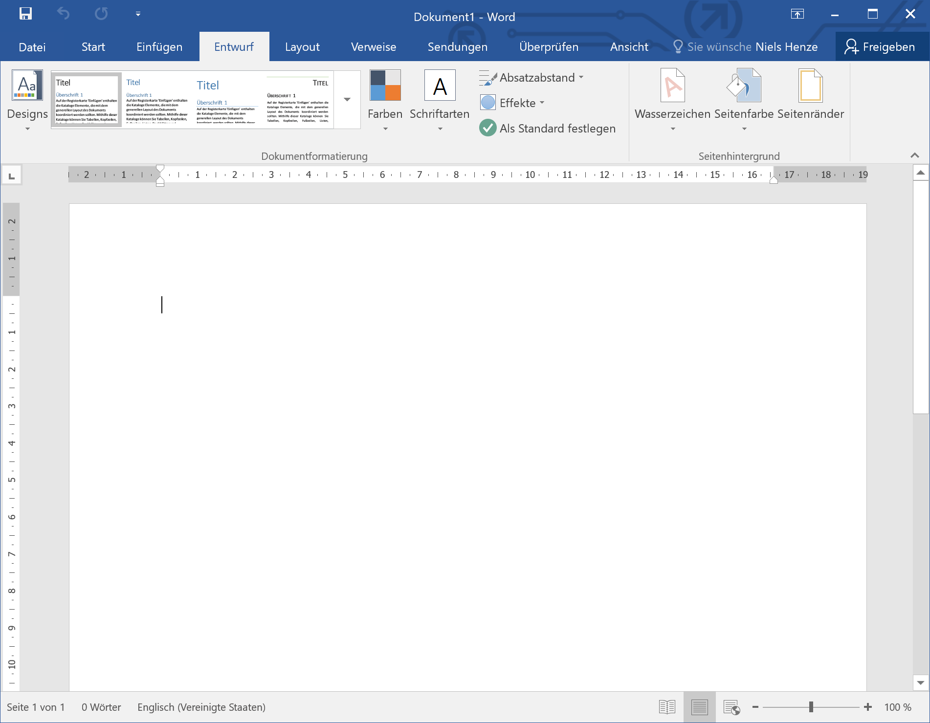
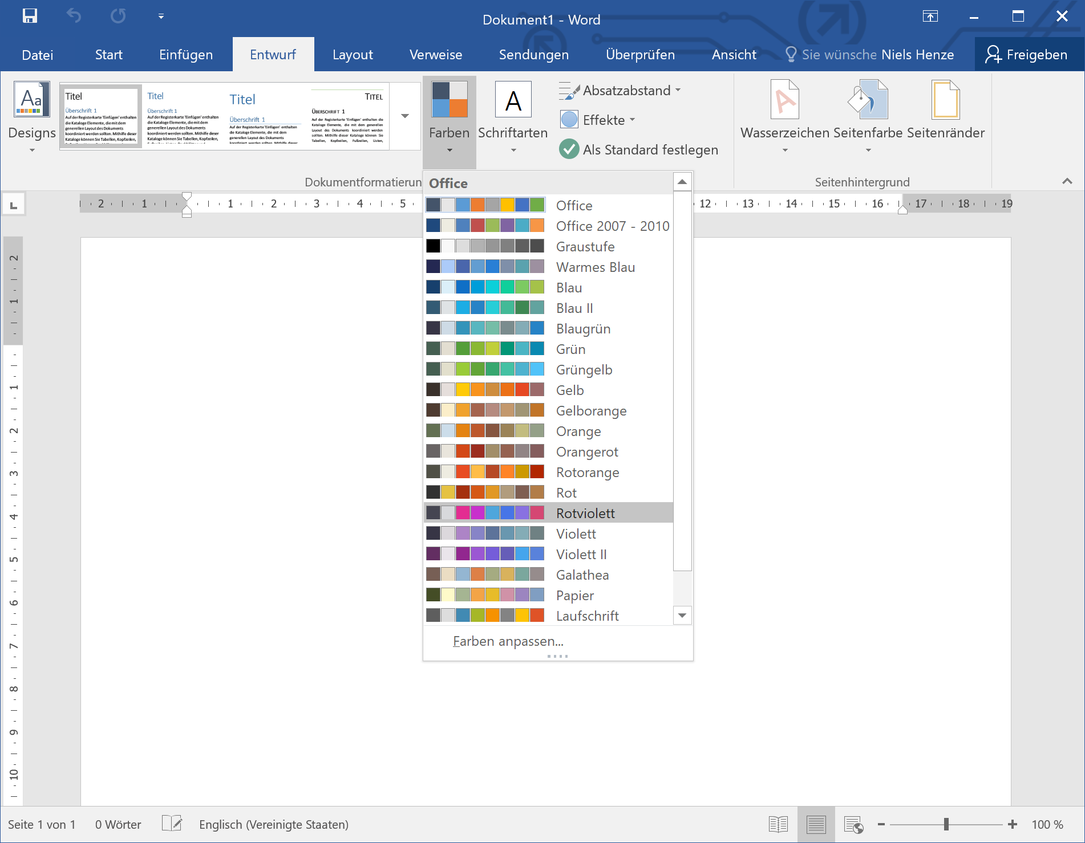
Horizontal Prototypes
Systemizing Prototypes

Slide 12
Horizontal Prototyping
Demonstrates the feature spectrum without implementing them
Helps to evaluate/test
Navigation (e.g. finding a specific function or feature)
Overall user interface concept
Feature placement
Accessibility
User preferences
Applicable in low-fidelity prototyping and high-fidelity prototyping
Used in early design stages
To determine the set of features to include
To decide on the user interface concept
Systemizing Prototypes

Slide 13
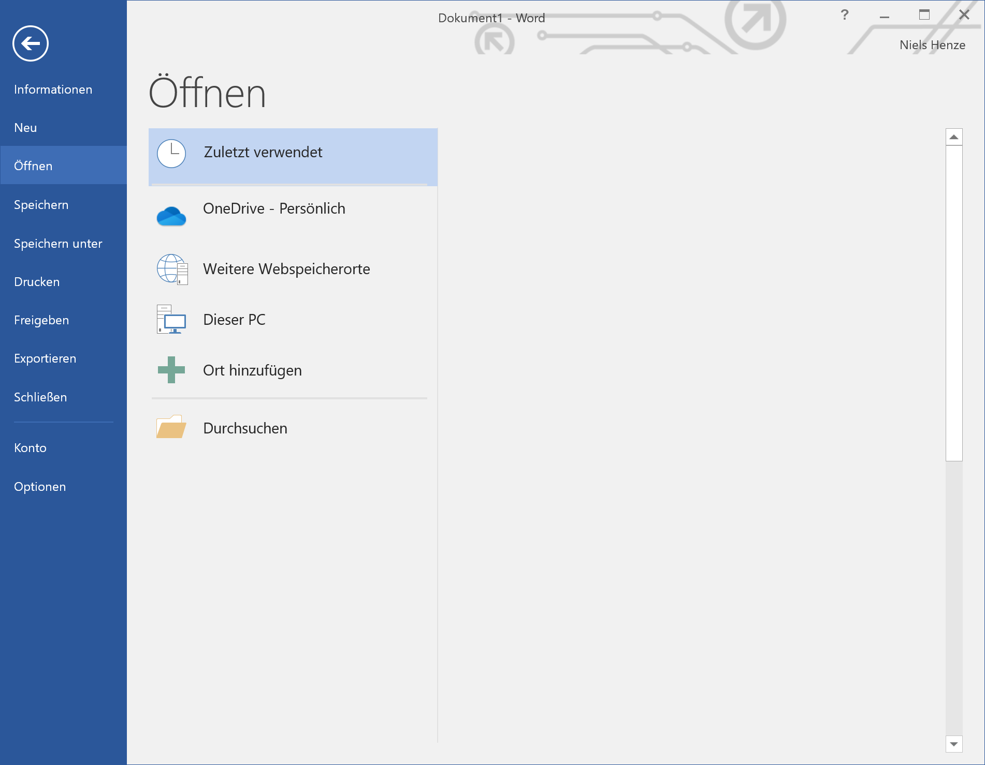
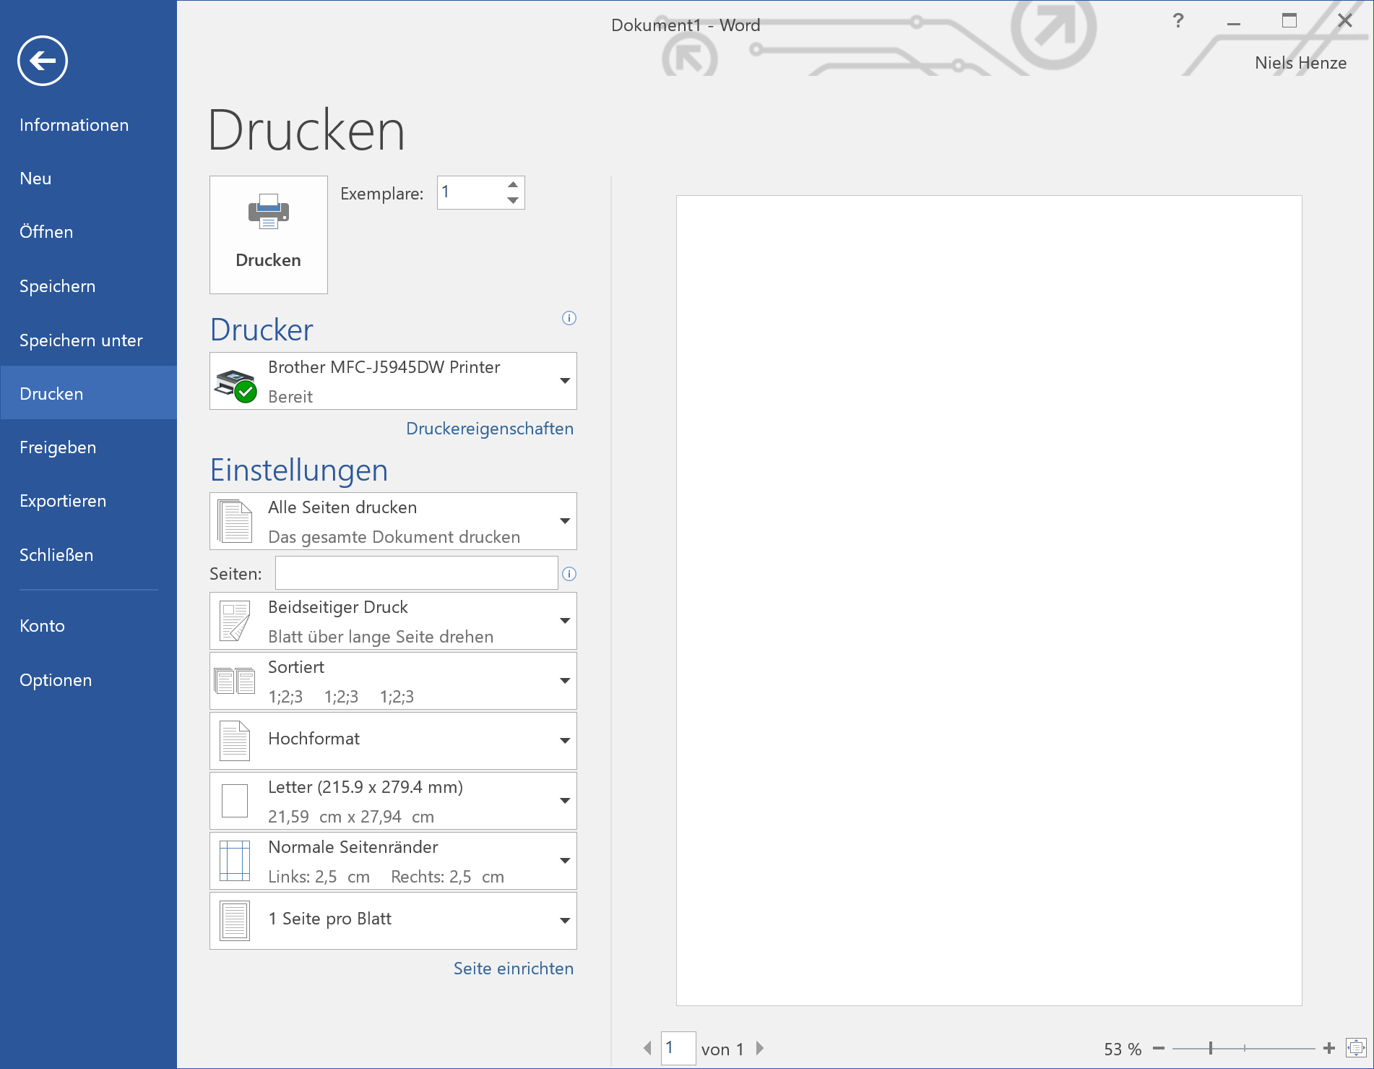
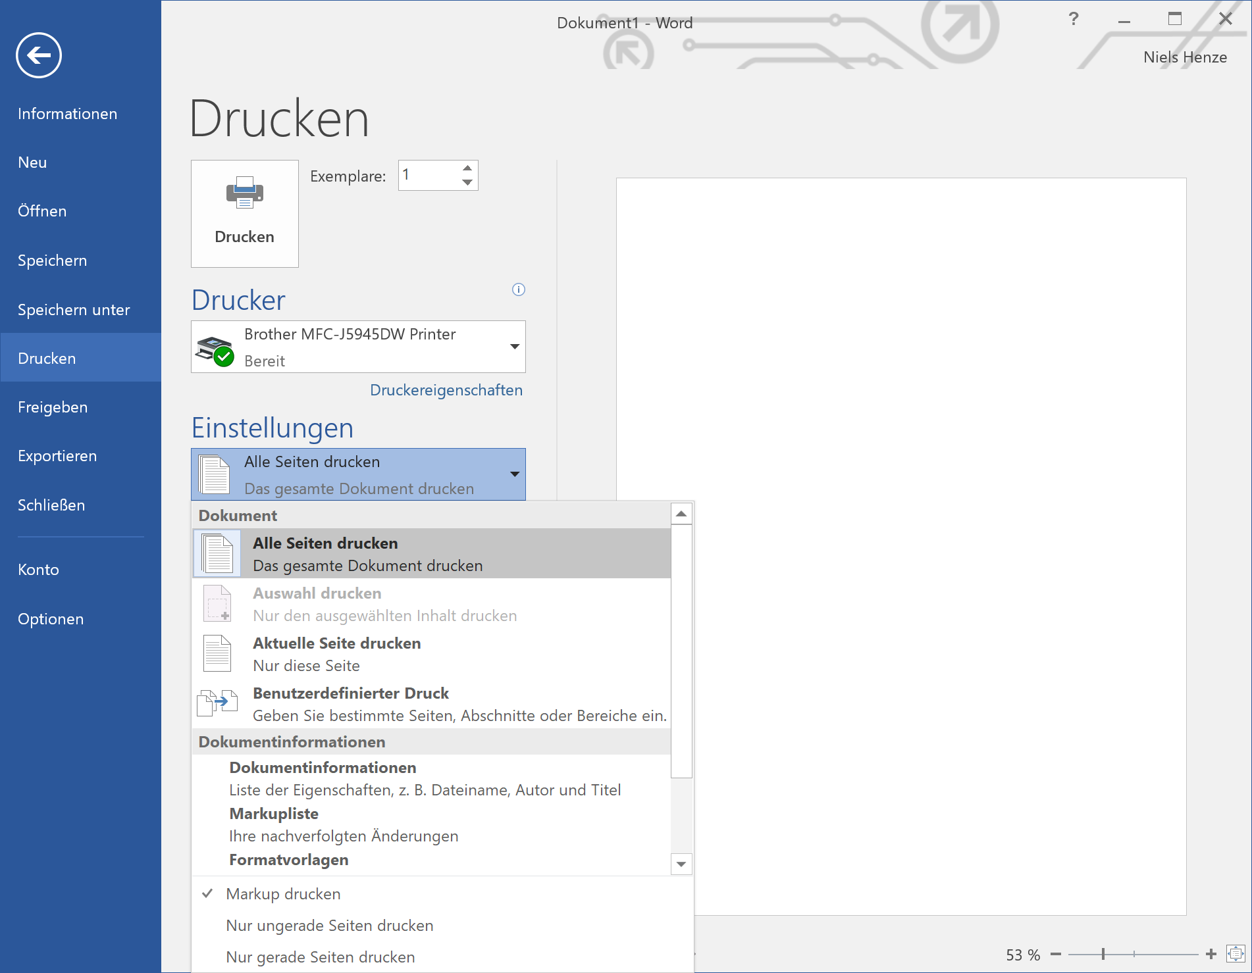
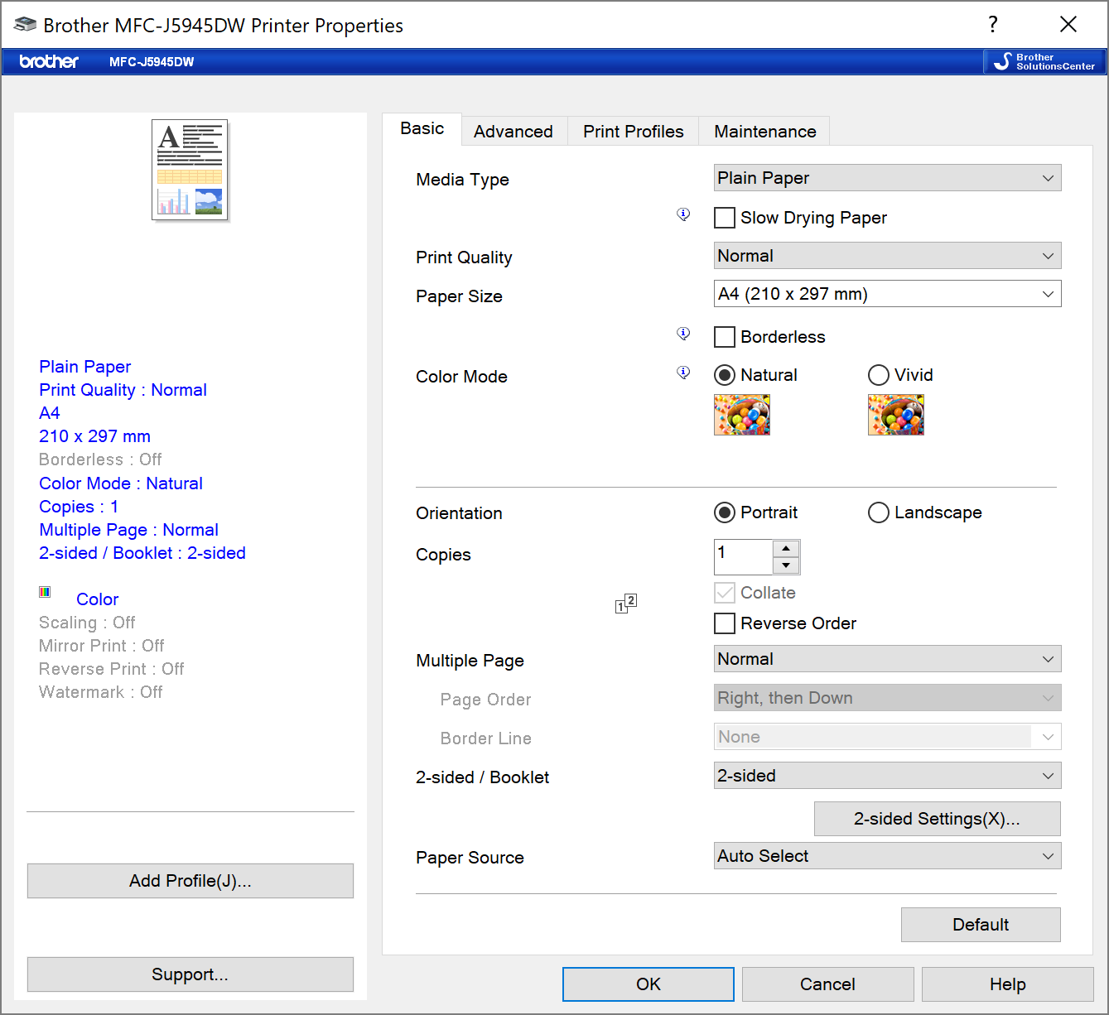
Horizontal Prototypes
Based on a photo by cottonbro from https://www.pexels.com/photo/man-using-a-printer-3201783 (PD)
Systemizing Prototypes

Slide 14
Vertical Prototyping
Demonstrate a specific feature
The details of the function/feature are shown/implemented
Helps to evaluate/test
The optimal design for a particular function
Optimize the usability of this function
User performance for this particular function
Often used in high-fi prototyping but is also applicable to low-fi prototyping
Systemizing Prototypes

Slide 15
Horizontal vs. Vertical Prototypes
Horizontal Prototype
Vertical Prototype
not prototyped
prototyped
Systemizing Prototypes

Slide 16
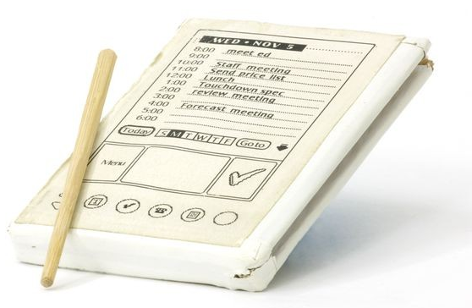
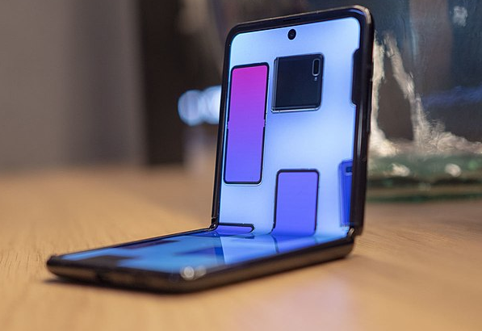
Low- vs. High-Fidelity Prototypes
Low-Fidelity PDA Prototype
High-Fidelity Prototype
Photo by Mark Richards from https://www.computerhistory.org/revolution/mobile-computing/18/321/1648
Image by Grace R. Samson from https://commons.wikimedia.org/wiki/File:Samsung_Galaxy_Z_Flip_fold.jpg (CC-BY-SA 4.0)
Systemizing Prototypes

Slide 17
Low-Fi prototypes
Check ideas and interaction flow
Fast, cheap and easy to change
Advantages
Cheap, easy and quick to implement
Users are keen to criticise
Disadvantages
No real functionality, difficult to identify errors
Reuse and extending difficult to impossible
Not all ideas can be realized
Photo by Mark Richards from https://www.computerhistory.org/revolution/mobile-computing/18/321/1648
Systemizing Prototypes

Slide 18
High-fidelity Prototype
Looks & feels like the final product
Colors, screen layout, fonts, … text used
Response time and interactive behavior
Restricted functionality
Only certain functions work
Functionality is targeted towards the tasks
Invisible issues (e.g. security)
Standard technologies for prototyping
HTML, JavaScript
Axure, Director, Presentation programs
GUI Builder (e.g. Visual Basic, Delphi, NetBeans)
Image by Grace R. Samson from https://commons.wikimedia.org/wiki/File:Samsung_Galaxy_Z_Flip_fold.jpg (CC-BY-SA 4.0)
Systemizing Prototypes

Slide 19
High-fidelity Prototype
Advantages
Show how the finished product will look and feel
Behaves like the final product for selected tasks
Allows predicting efficiency
Disadvantages
Can be very time-consuming to implement
Users can only “use” the implemented functions
Feedback centered around look & feel
Managers may expect that “the product” is nearly ready
Systemizing Prototypes

Slide 20
Functionality vs. Fidelity
final system
functionality
click prototype
paper prototypes
wireframe
static powerpoint slides
fidelity
Systemizing Prototypes

Slide 21
Feedback depends on prototype
Systemizing Prototypes

Slide 22
License
This file is licensed under the Creative Commons Attribution-Share Alike 4.0 (CC BY-SA) license:
https://creativecommons.org/licenses/by-sa/4.0
Attribution: Niels Henze
For more content see: https://hci-lecture.de

